Slide 1
HYDRATION ASSESSMENT & RECOMMENDATIONS
Lecture content provided by GSSI, a division of PepsiCo, Inc. Any opinions or scientific interpretations expressed in this presentation are those of the author and do not necessarily reflect the position or policy of PepsiCo, Inc.

Slide 2
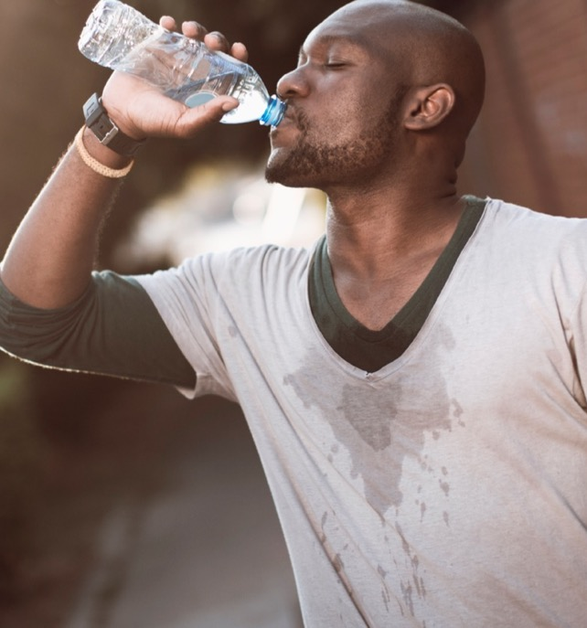
Body Water and Electrolyte Basics
Total body water
Hydration terminology
Fluid compartments
Role of sodium in fluid balance
Hydration physiology
Hydration and performance

Slide 3
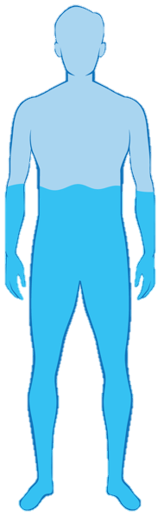
Total Body Water
~50-70% of body mass
TBW = ~0.73 x fat free mass

Slide 4
Hydration Terminology
Hyperhydration / Overhydration
Dehydration
± 2% Total Body Water
Euhydration
Dehydration
Rehydration
Hypohydration
Greenleaf J. Med Sci Sports Exerc. 1992;24(6):645-656

Slide 5
Hydration Terminology
Euhydration – “normal” body water content within homeostatic range
Dehydration – the process of dynamic loss of body water – e.g., the transition from euhydration to hypohydration
Rehydration – the process of dynamic gain of body water (via fluid intake) – e.g., the transition from hypohydration to euhydration
Hypohydration – state of body water deficit
Over- or Hyperhydration – state of body water excess

Slide 6
Fluid Compartments
PLASMA
INTERSTITIAL
Extracellular Fluid (ECF)
35-45% of TBW
~50-70% of body mass
TBW = ~0.73 x fat free mass
Intracellular Fluid (ICF)
55-65% of TBW

Slide 7
Role of Sodium in Fluid Balance
Plasma
Sodium (Na⁺) is the most abundant electrolyte in the extracellular space
Sodium controls water movement between fluid compartments
Water follows solute to maintain osmotic equilibrium
Na⁺
Na⁺
Na⁺
Na⁺
K⁺
Na⁺
K⁺
Na⁺
Na⁺
Na⁺
Na⁺
Na⁺
ECF
ISF
K⁺
Na⁺
Na⁺
Na⁺
Na⁺
Na⁺
K⁺
K⁺
Na⁺
K⁺
K⁺
ICF
K⁺
K⁺
K⁺
Na⁺
K⁺
K⁺
K⁺

Slide 8






Role of Sodium in Fluid Balance
SSE #111
Stimulates thirst – leading to increased fluid intake and better maintenance or restoration of euhydration
Helps maintain proper fluid and electrolyte balance among fluid compartments
Supports cardiovascular function during exercise via better maintenance of plasma volume
Promotes whole body rehydration by stimulating renal fluid retention (decreased urine loss)
Stachenfeld NS. Sports Science Exchange. 2013;26(111)

Slide 9
Hydration Physiology - Hypohydration
Hypohydration – body water deficit
Hypovolemia – decreased plasma volume
Hyperosmolality – increased plasma osmolality (concentration of dissolved solutes, mostly sodium, in the blood)
↑ Cardiovascular strain – lower stroke volume and higher heart rate
↑ Body core temperature – decreased ability to dissipate body heat through sweating and skin blood flow
↑ Fatigue - early onset of fatigue leading to reduced performance

Slide 10
Hydration Physiology - Overhydration
Overdrinking low or no sodium fluids
Overhydration – body mass gain because of a fluid surplus
Exercise Associated Hyponatremia – dilution of plasma sodium concentration to < 135 mmol/L
Water flux into the ICF –severity of symptoms related to cell swelling depends on how much and how fast plasma sodium [Na⁺] decreases
SSE #111
+ prolonged exercise (>4 hours)
+ smaller individual (low baseline total body water)
+ excessive sodium loss
Additional risk factors
Noakes TD, Goodwin N, Rayner BL, et. al. Med Sci Sports Exerc. 1985;17(3):370-375
Hew-Butler TD, Godek SF, Rosner M, et. al. Br J Sports Med. 2015;25:303-320

Slide 11

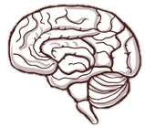






Hydration and Performance
Cognition
Team Sports
Aerobic Exercise
Muscle Endurance,
Strength, &
Anaerobic Power
SSE
#128, 152, 165
Hypohydration can impair performance, especially if
exceeds 2-3% body mass loss and in hot/humid conditions
Laitano et. al. Sports Science Exchange. 2014;27(128)
Sawka et. al. Sports Science Exchange. 2015;28(152)
Baker. Sports Science Exchange. 2016;28(165)
McDermott BP, Anderson SA, Armstrong LE, et. al. J Athl Train. 2017;52(9):877-895
Thomas DT, Erdman KA, Burke LM. Med Sci Sports Exerc. 2016;48(3):543-568

Slide 12
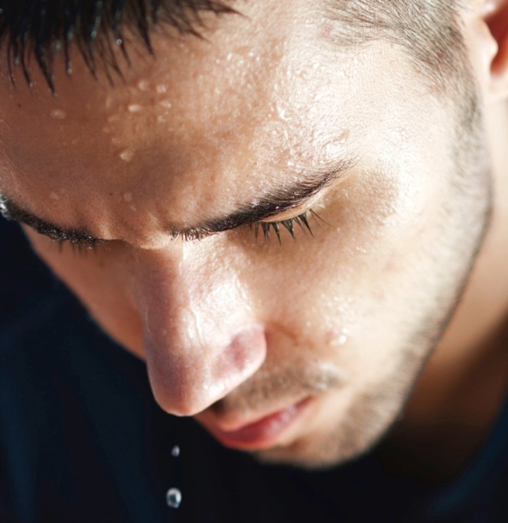
Fluid Balance
Assessment before exercise
Hydration status
Sweat loss
Sweating rate
Data collection
Example calculations

Slide 13
Can you think of a simple way for an Athletic Trainer or Sports Dietitian to monitor the hydration status of their athletes?

Slide 14
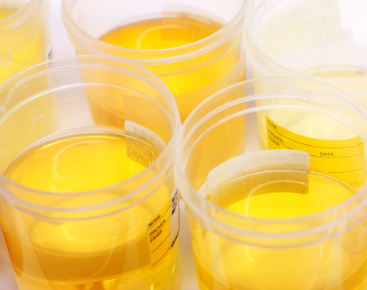
Monitoring Hydration Status: Urine Color
Urine color can be used as a reliable marker of hydration status
Athletes with a urine color of 5 on a urine color chart are 6 times more likely to be hypohydrated
A mean urine color of 3 provides a reasonable assurance the athlete is hydrated
Urine color can be monitored by the athlete or by the ATC
Post urine color charts in bathrooms
McKenzie AL, Muñoz CX, Armstrong LE. J Athl Train. 2015;50(12):1306‐1309

Slide 15


Hydration Assessment Before Exercise
Are you hypohydrated?
SSE #92
Is my body mass >1% lower than normal?
Yes / No
Likely
Likely
Very Likely
Is my urine dark yellow?
Am I Thirsty?
Yes / No
Likely
Yes / No
Assess first thing in the morning (before breakfast)
Cheuvront & Sawka. Sports Science Exchange. 2005;18(2)

Slide 16
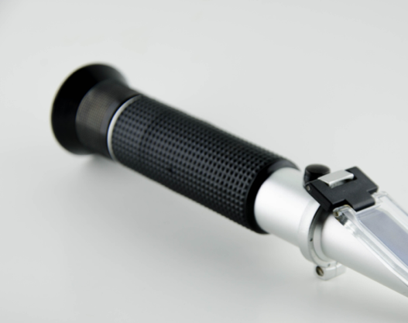
Urine Specific Gravity (USG)
USG is sensitive to changes in hydration state
ACSM & NATA recommend cut-off points for dehydration of ≥1.020 for USG.
Medications can alter urine color and USG including vitamins
Best to use more than one measure (ie: change in body weight, urine color and USG)
Armstrong LE, Johnson EC, McKenzie AL, Muñoz CX. J Clin Nutr. 2013;67(3):249‐253

Slide 17
MONITORING HYDRATION DURING PLAY

Slide 18
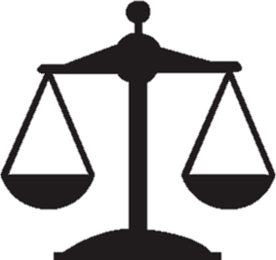

Hydration Status
Body mass loss
Sweat
Urine
Body mass gain
Drinking
Eating
Respiration
(fuel oxidation, water vapor)
Hydration status = % change in nude body mass
Example: 2% hypohydration = 2% body mass deficit through fluid loss
Calculation: [(∆ body mass) / baseline body mass]*100

Slide 19

Hydration Status
2007 Fluid Replacement Position Stand
Acute body mass change can be used to calculate sweating rate and perturbations in hydration status when corrected for urine losses, drink volume, and trapped sweat.
Other non-sweat factors (fuel oxidation and respiratory water loss) can overestimate sweating rate but do not require correction for < 3 h exercise.
Therefore, using acute body mass change to estimate hydration status is appropriate for most individual and team sports, since practices and games are typically < 3 h.
Sawka MN, Burke LM, Eichner ER, et. al. Med Sci Sports Exerc. 2007;39(2):377-390

Slide 20
Hydration Status
Using change in body mass to determine hydration status becomes less accurate with longer events
For example, during ultraendurance events ≥ 2% of body mass loss can occur through non sweat sources:
Sweat
Non-sweat
161-km mountain ultramarathon running competition (~25-30 h)
Total Mass Loss (kg)
0.2% 0.8% 2.0%
1.2-3.5% of body mass loss due to non-sweat sources
Hoffman et al. Sports Med, 2017
Correction in Sports Med, 2018.
10
42
100
Distance Run (km)
Cheuvront and Kenefick. J Appl Physiol. 2017;123(3):632-636

Slide 21
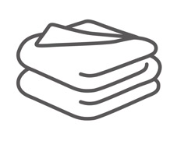
Data Collection - Change in Hydration Status
Supplies needed
Instructions
Digital platform body weight scale with precision of 0.10 kg or better
Towels
Before Exercise
Ask athlete to use restroom, void bladder and bowels
Weigh athlete while they are wearing minimal clothing (e.g., compression shorts, sports bra)
After Exercise
Ask athlete to towel dry thoroughly
Weigh athlete while wearing the same minimal clothing as before exercise
SSE #161
Baker. Sports Science Exchange. 2016;28(161)

Slide 22
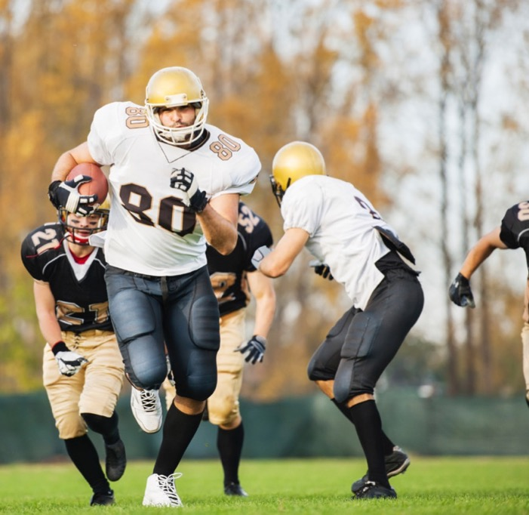
Example #1
Data
Baseline body mass: 104.55 kg
Post-exercise body mass: 101.00 kg

Slide 23
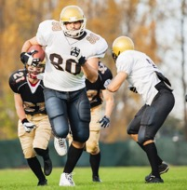
Example #1
Calculate the athlete’s % change in hydration status after practice
Body mass decreased from 104.55 kg to 101.00 kg, so ∆ body mass = -3.55 kg
Hydration status = [(∆ body mass) / baseline body mass]*100
(-3.55 kg / 104.55 kg ) *100
-3.4% change in body mass

Slide 24
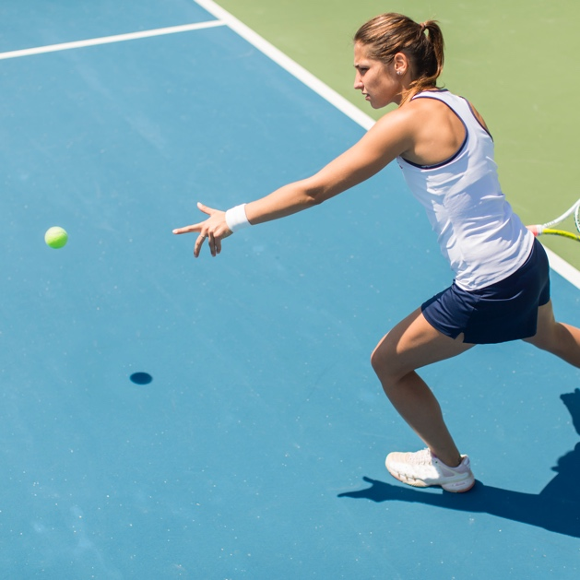

Example #2
Data
Baseline body mass: 56.35 kg
Post-match body mass: 55.45 kg

Slide 25
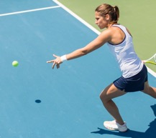
Example #2
Calculate the athlete’s % change in hydration status after the match
Body mass decreased from 56.35 kg to 55.45 kg, so ∆ body mass = -0.90 kg
Hydration status = [(∆ body mass) / baseline body mass]*100
(-0.90 kg / 56.35 kg ) *100
-1.6% change in body mass

Slide 26
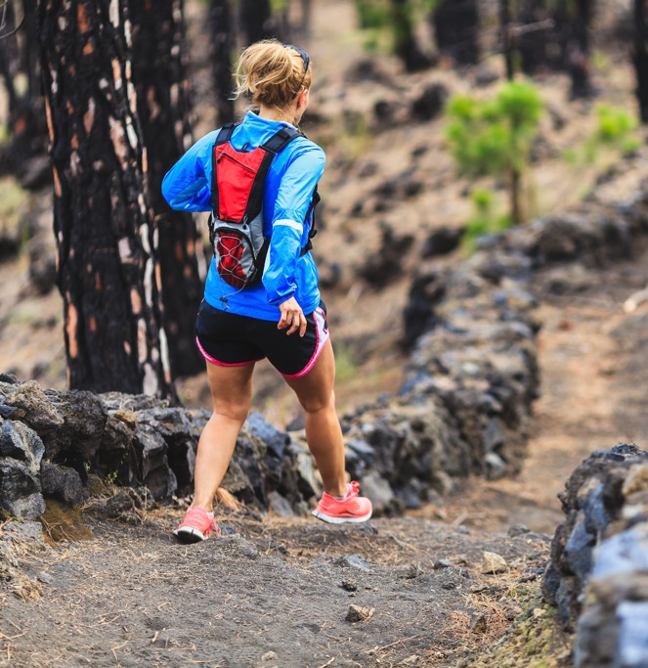
Example #3
Data
Baseline body mass: 66.15 kg
Post exercise body mass: 66.80 kg

Slide 27
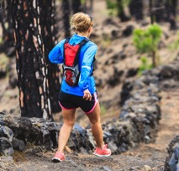
Example #3
Calculate the athlete’s % change in hydration status after exercise
Body mass increased from 66.15 kg to 67.00 kg, so ∆ body mass = +0.65 kg
Hydration status = [(∆ body mass) / baseline body mass]*100
(0.65 kg / 66.15 kg ) *100
+1.0% change in body mass

Slide 28
Sweating Rate – Normative Data in Athletes
Athlete, Environment, and Exercise Information | Mean ± SD (Range)
Age (years) | 24 ± 9 (9-70)
Body Mass (kg) | 84 ± 24 (23-178)
Air Temp (°C) | 26 ± 5 (11-50)
Relative Humidity (%) | 55 ± 17 (13-95)
Exercise Duration (h) | 1.7 ± 0.7 (0.5-5.4)
Number of Athletes
Mean
n=1303
Sweating Rate (L/h)
Barnes KA, Anderson ML, Stofan JR, et. al. J Sports Sci. 2019;37(20):2356-2366

Slide 29



Sweating Rate – Normative Data by Sport
c
b
a
a
a
Whole-Body Sweating Rate (L/h)
Sports sharing same letter are not different (p>0.05)
n=161
n=268
n=196
n=255
n=271
Barnes KA, Anderson ML, Stofan JR, et. al. J Sports Sci. 2019;37(20):2356-2366

Slide 30
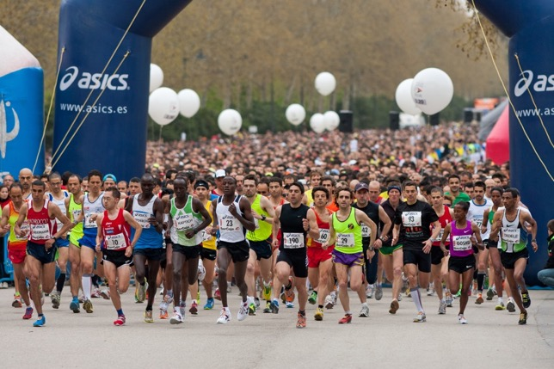
Factors impacting the variability in sweating rate
Exercise intensity
Body size
Environmental conditions
(temperature, humidity, solar load, wind)
Heat acclimatization
Fitness
Clothing/equipment worn
Body composition
Hydration status
Age (maturation)
Genetics
Methodology

Slide 31

Sweat Loss Calculations
Mass gain
Drinking
Eating
Mass loss
Sweat
Urine
Respiration
(fuel oxidation,
water vapor)
Sweat Loss = [Pre-Ex Body Mass – (Post-Ex Body Mass – Fluid & Food + Urine & Resp)]
Respiratory losses = 0.2 g/kcal of energy expended during exercise. Because of the relatively small contribution of respiratory losses to total body mass loss and because energy expenditure is difficult to measure, this part of the equation is usually dropped for acute bouts of exercise.
Sweat Loss = [Pre-Ex Body Mass – (Post-Ex Body Mass – Fluid & Food + Urine)]
Sawka MN, Burke LM, Eichner ER, et. al. Med Sci Sports Exerc. 2007;39(2):377-390
Cheuvront and Montain. Exp Physiol. 2017;102:1047-1053
Cheuvront and Kenefick. J Appl Physiol. 2017;123(3):632-636

Slide 32


Data Collection – Sweat Rate
SSE #161
Instructions
Supplies needed
Before Exercise
Ask athlete to use the restroom, void bladder and bowels
Weigh athlete while he/she is wearing minimal clothing (e.g., compression shorts, sports bra)
Weigh drink bottles and food (bars, gels, etc), if applicable
During Exercise
Collect urine loss in cup and weigh, if applicable
After Exercise
Ask athlete to towel dry thoroughly
Weigh athlete while wearing the same minimal clothing as before exercise
Weigh drink bottles and food, if applicable
Digital platform body weight scale with precision of 0.10 kg or better
Towels
Clock or Stopwatch
Drink Bottles
Small digital scale
Urine cup

Slide 33
Example #1
Data
Baseline body mass: 104.55 kg
Practice duration: 2.5 h
Fluid consumed: 1.25 kg
Food consumed: two 50-g energy bars
Urine loss = N/A
Post exercise body mass: 101.00 kg

Slide 34
Example #1
Calculate the athlete’s sweat rate
Sweat Loss = [Pre-Ex Body Mass – (Post-Ex Body Mass – Fluid & Food + Urine)]
104.55 kg - (101.00 kg -1.35 kg + 0 kg)
4.90 kg (or L) of sweat lost in 2.5 h
Sweat Rate = 4.90 L / 2.5 h = 1.96 L/h

Slide 35
Example #2
Data
Baseline body mass: 56.35 kg
Match duration: 1.5 h
Fluid consumed: 0.85 kg
Urine loss: N/A
Post exercise body mass: 55.45 kg

Slide 36
Example #2
Calculate the athlete’s sweat rate
Sweat Loss = [Pre-Ex Body Mass – (Post-Ex Body Mass – Fluid & Food + Urine)]
56.35 kg - (55.45 kg - 0.85 kg + 0 kg)
1.75 kg (or L) of sweat lost in 1.5 h
Sweat Rate = 1.75 L / 1.5 h = 1.17 L/h

Slide 37
Example #3
Data
Baseline body mass: 66.15 kg
Exercise duration: 2 h 20 min
Fluid consumed: 2.05 kg
Urine loss: 0.20 kg
Post exercise body mass: 66.80 kg

Slide 38
Example #3
Calculate the athlete’s sweat rate
Sweat Loss = [Pre-Ex Body Mass – (Post-Ex Body Mass – Fluid & Food + Urine)]
66.15 kg - (66.80 kg -2.05 kg + 0.20 kg)
1.20 kg (or L) of sweat lost in 2.33 h
Sweat Rate = 1.20 L / 2.33 h = 0.52 L/h

Slide 39


Planned Drinking vs Drinking to Thirst
SSE #182
Drink to Thirst
Planned Drinking
Short duration activities < 60 to 90 min
Cooler conditions
Lower intensity
Longer duration activities > 90 min
Particularly in the heat
High intensity
High sweat rates
When performance is a concern
When carbohydrate intake of 1 g/min
Kenefick RW. Sports Science Exchange. 2018;29(182)

Slide 40
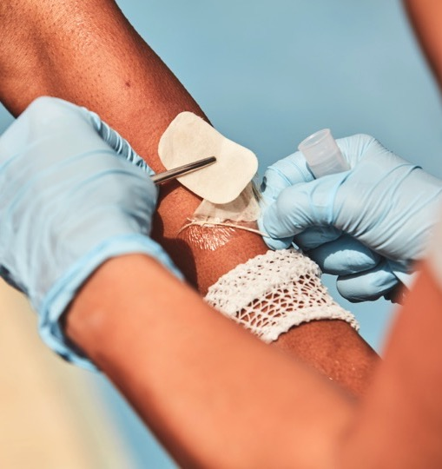
Electrolyte Balance
Sweat composition
Sweat sodium concentration
Sweat sodium loss
Data collection
Example calculations

Slide 41
Sweat Composition
 | Concentration
Sodium | 10-90 mmol/L
Chloride | 10-90 mmol/L
Lactate | 5-40 mmol/L
Urea | 4-12 mmol/L
Potassium | 2-8 mmol/L
Ammonia | 1-8 mmol/L
Others (e.g., bicarbonate, calcium, magnesium, glucose, amino acids, iron, copper, zinc) | < 1 mmol/L each
Baker and Wolfe. Eur J Appl Physiol. 2019;120:719-752

Slide 42
Sweat Sodium Loss – Athlete Normative Data
Athlete, Environment, and Exercise Information | Mean ± SD (Range)
Age (years) | 24 ± 9 (9-70)
Body Mass (kg) | 84 ± 24 (23-178)
Air Temp (°C) | 26 ± 5 (11-50)
Relative Humidity (%) | 55 ± 17 (13-95)
Exercise Duration (h) | 1.7 ± 0.7 (0.5-5.4)
Number of Athletes
Mean
n=1303
Sweat Sodium Loss (mmol/h)
Barnes KA, Anderson ML, Stofan JR, et. al. J Sports Sci. 2019;37(20):2356-2366

Slide 43
Sweat Sodium Loss – Normative Data by Sport
c
c
ab
b
a
Sports sharing same letter are not different (p>0.05)
Sweat Sodium Loss (mmol/h)
n=161
n=268
n=196
n=255
n=271
Barnes KA, Anderson ML, Stofan JR, et. al. J Sports Sci. 2019;37(20):2356-2366

Slide 44



Data Collection – Sweat Sodium Concentration
Supplies needed
SSE #161
Instructions
Absorbent sweat patch
Forceps
Alcohol wipes and/or deionized water
Gauze or paper towels
Gloves
Storage tube
Analytical device
Before Exercise
Clean the athlete’s forearm with alcohol and/or deionized water, wipe dry
Apply patch to mid-forearm
During/After Exercise
Monitor patch via visual inspection
Use gloved hands and clean forceps to remove patch upon moderate saturation
Place absorbent pad into storage tube
Storage/Anlaysis
If analysis is not done immediately, seal tube and store refrigerated for up to 1 week
Measure sodium concentration using ion chromatography or ion selective electrode
Use published regression equations to predict whole body sweat sodium concentration

Slide 45
Example #1
Data
Forearm sweat sodium concentration: 80 mmol/L
Practice duration: 2.5 h
Sweat loss: 4.90 L

Slide 46
Example #1
Calculate the athlete’s total sweat sodium loss
Whole Body Sweat [Na⁺] = 0.57(80 mmol/L) +11.05 = 56.65 mmol/L
Whole Body Sweat Sodium Loss = 56.65 mmol/L * 4.90 L = 277.59 mmol
= 277.59 mmol * 22.99 mg/mmol
= 6382 mg sodium

Slide 47
Example #2
Data
Forearm sweat sodium concentration: 62 mmol/L
Match duration: 1.5 h
Sweat loss: 1.75 L

Slide 48
Example #2
Calculate the athlete’s total sweat sodium loss
Whole Body Sweat [Na⁺] = 0.57(62 mmol/L) +11.05 = 46.39 mmol/L
Whole Body Sweat Sodium Loss = 46.39 mmol/L * 1.75 L = 81.18 mmol
= 81.18 mmol * 22.99 mg/mmol
= 1866 mg sodium

Slide 49
Example #3
Data
Forearm sweat sodium concentration: 38 mmol/L
Exercise duration: 2 h 20 min
Sweat loss: 1.20 L

Slide 50
Example #3
Calculate the athlete’s total sweat sodium loss
Whole Body Sweat [Na⁺] = 0.57(38 mmol/L) +11.05 = 32.71 mmol/L
Whole Body Sweat Sodium Loss = 32.71 mmol/L * 1.20 L = 39.25 mmol
= 39.25 mmol * 22.99 mg/mmol
= 902 mg sodium

Slide 51
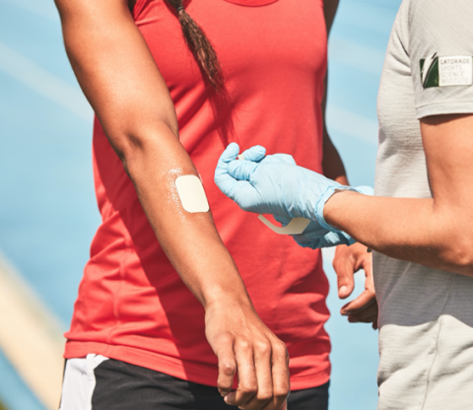
Recommendations
Begin exercise properly hydrated
Use a personalized fluid intake strategy based on sweat test results, exercise duration, and environmental conditions
Drink enough fluid to prevent >2% dehydration, especially in warm weather
Do not overconsume fluids during exercise
Consume sodium with fluids if exercise is >2 h in hot weather and/or if sweat electrolyte losses are very high (> 3 g)
McDermott BP, Anderson SA, Armstrong LE, et. al. J Athl Train. 2017;52(9):877-895
Thomas DT, Erdman KA, Burke LM. Med Sci Sports Exerc. 2016;48(3): 543-568
Racinais S, Alonso JM, Coutts AJ, et. al. Scand J Med Sci Sports. 2015;25(1):6-19
Sawka MN, Burke LM, Eichner ER, et. al. Med Sci Sports Exerc. 2007;39(2):377-390

Slide 52
Link to Summary Video

